Slide 1
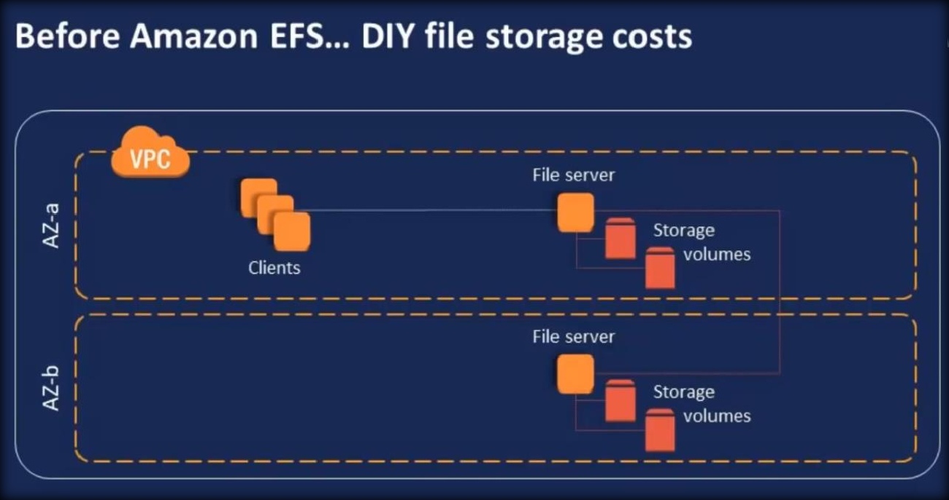
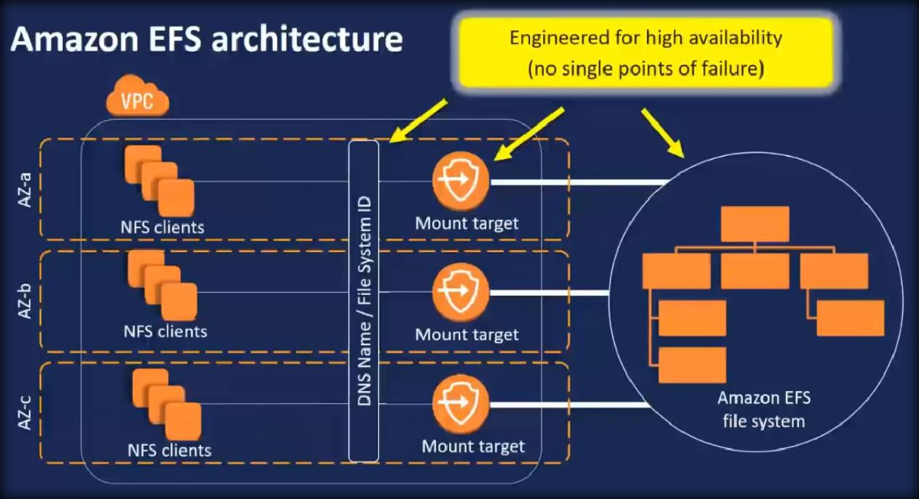
31. ELASTIC FILE SYSTEM

Slide 2
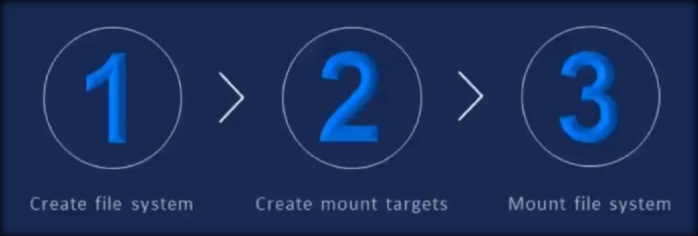
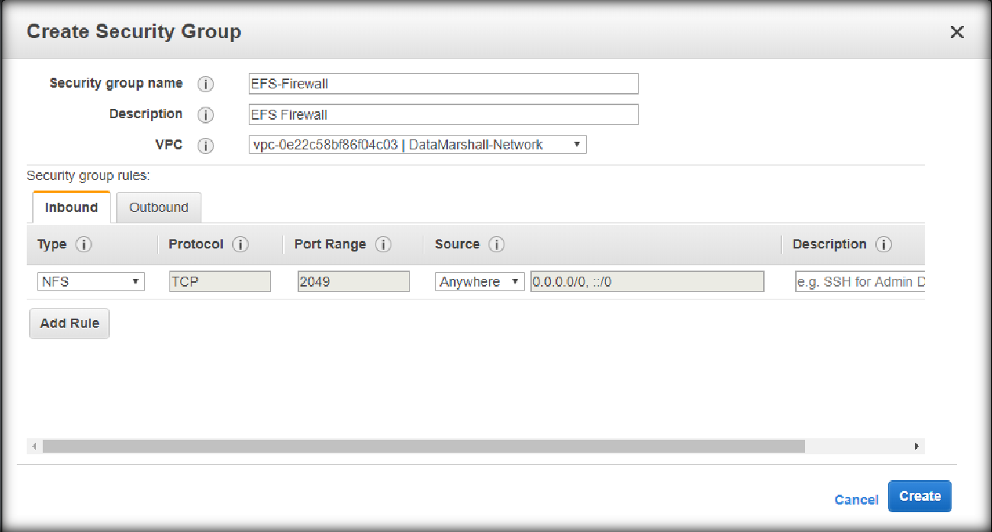
Create a security group which has NFS port open from all locations, named it as EFS security group.
Then go to EFS from Storage services.

Slide 3
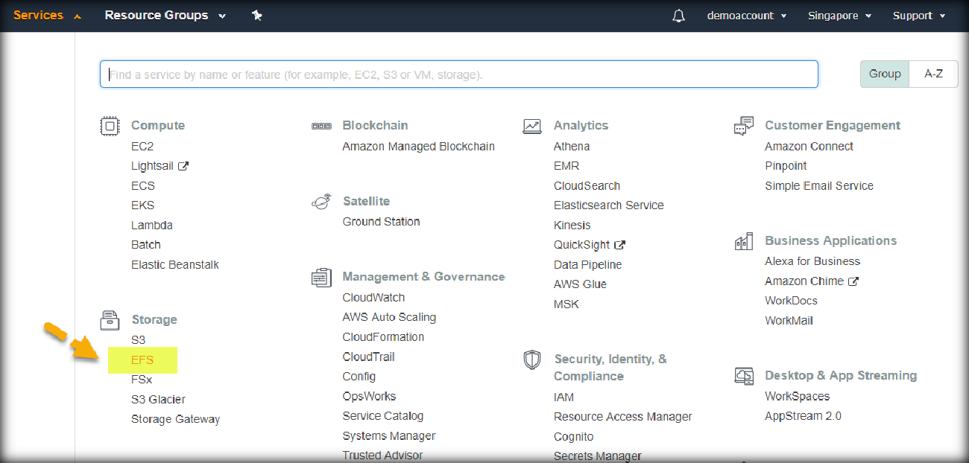
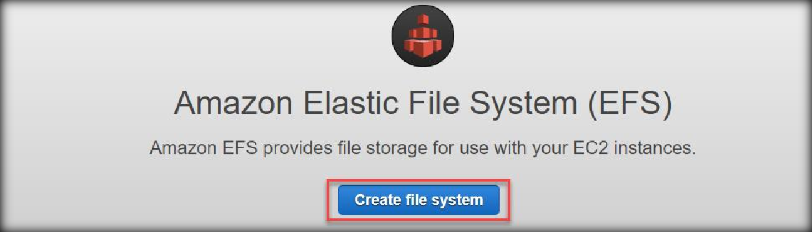
Once you are in EFS, click on create file system to create EFS.
Select the created efs security group for all the mount targets.

Slide 4
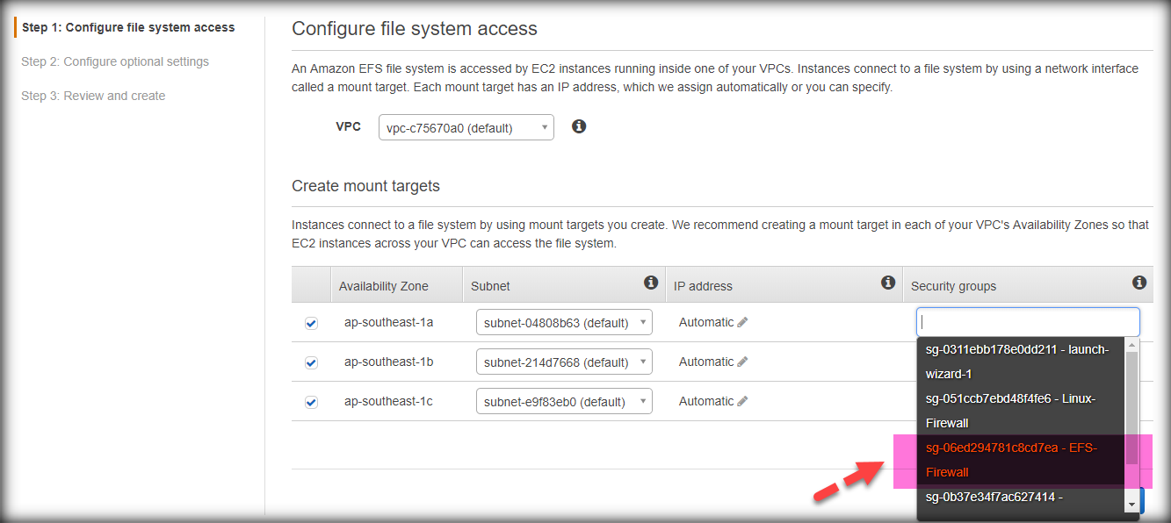
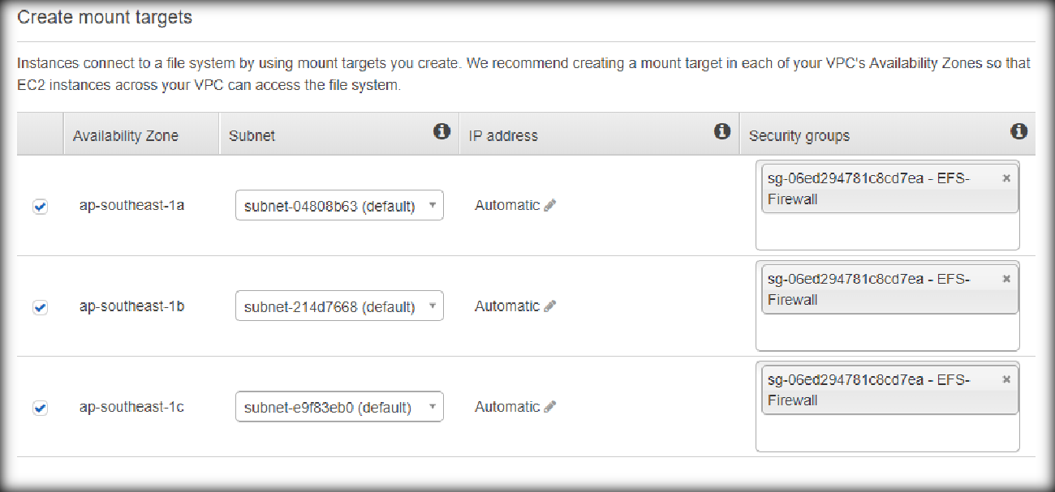
Once changed, will be look like the below.
Add a name tag like below.

Slide 5
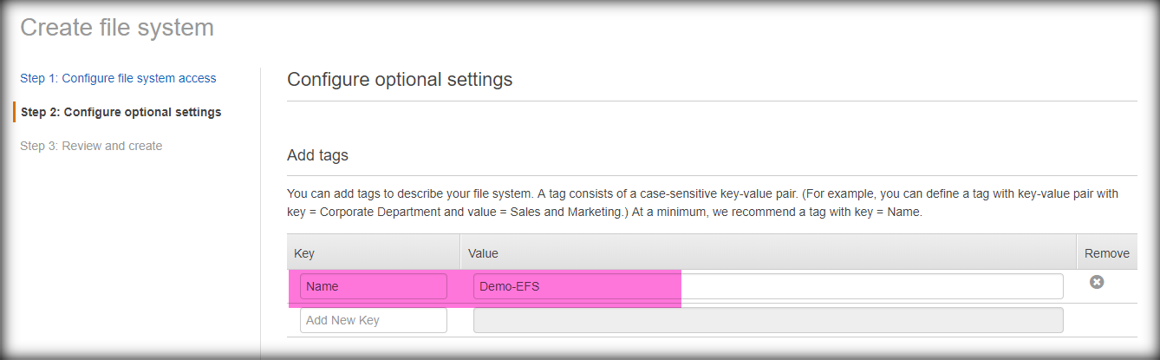
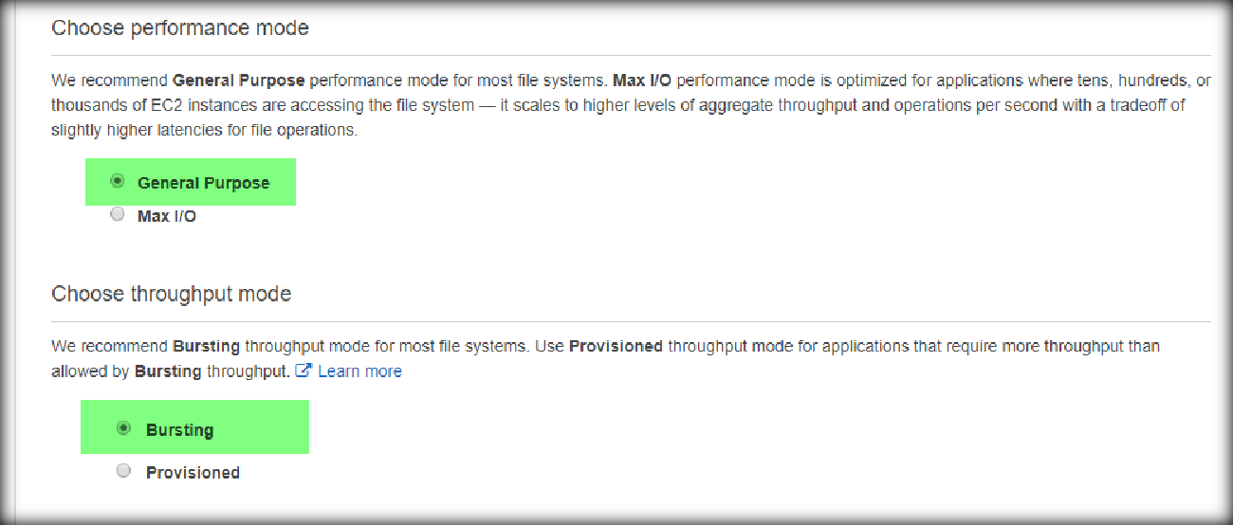
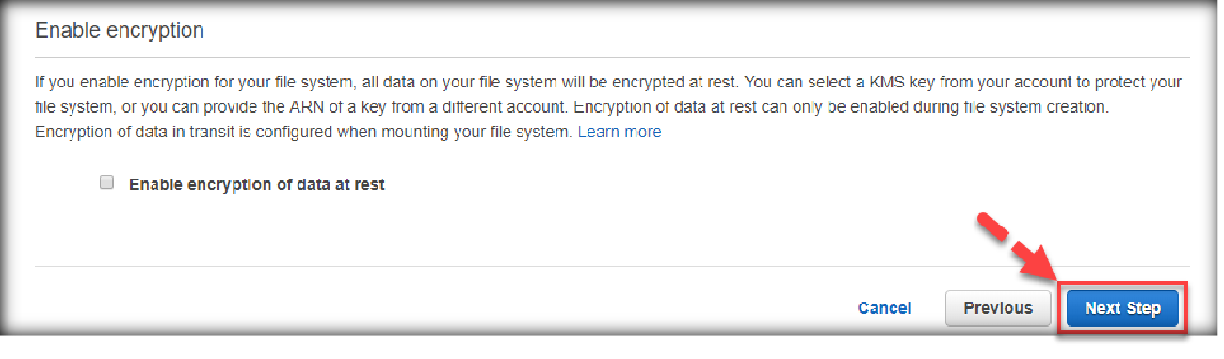
Select the performance options like below.
Specify the encryption and click on Next step.

Slide 6
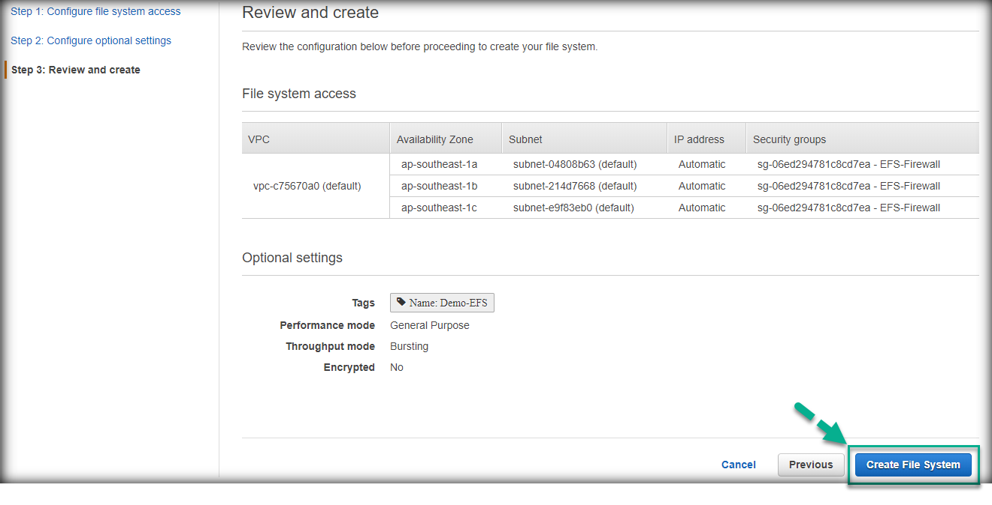

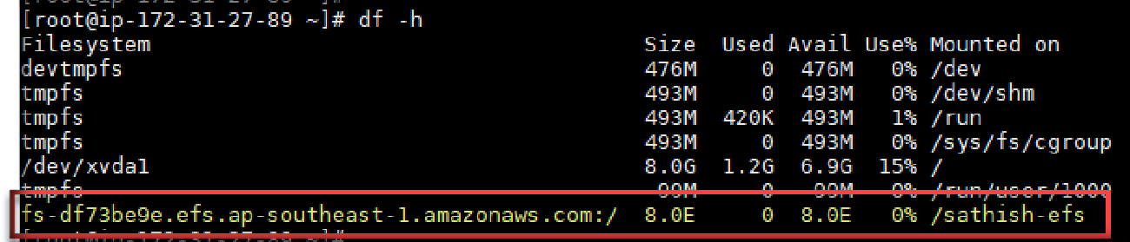
Finally click on Create file system to create it.
Install nfs-utils package on RHEL based servers, run “ apt-get install nfs-common ” for Debian based systems.
Create a folder in the server to mount the EFS storage.
Then mount EFS storage file system using the below command.
mount -t nfs4 -o nfsvers=4.1,rsize=1048576,wsize=1048576,hard,timeo=600,retrans=2,noresvport fs-
df73be9e.efs.ap-southeast-1.amazonaws.com:/ /sathish-efs
Run the same command and both the servers.

